Slide 1
STM32 – DIST.
Micro101

Slide 2
Tools Overview
Overview Portfolio
Evaluation Boards
Free IDEs
AC6
CoIDE
Keil (M0/M0+)
mbed
Ecosystem
STM32CubeMX
STLink Utility
ST Visual Programmer (STVP)
STM32 Flash Loader Demonstrator
Dfuse
STM Studio

Slide 3









ST has licensed all Cortex®-M cores
Forget traditional 8/16/32-bit classifications and get
Seamless architecture across all applications
Every product optimized for ultra-low power and ease of use
Cortex-M0/M0+
Cortex-M3
Cortex-M4
Cortex-M7
MCU
8/16-bit applications
16/32-bit applications
16/32-bit DSC applications
16/32-bit DSC applications
Binary and tool compatible
Notes:
ST is a leading partner with ARM for Cortex-M cores, participating in the definition of these cores. Today, the STM32 portfolio includes [CLICK] the full panel of Cortex-M cores, from the Cortex-M0 and Cortex-M3 to the Cortex-M4. The portfolio offers more than 300 devices in full production.

Slide 4
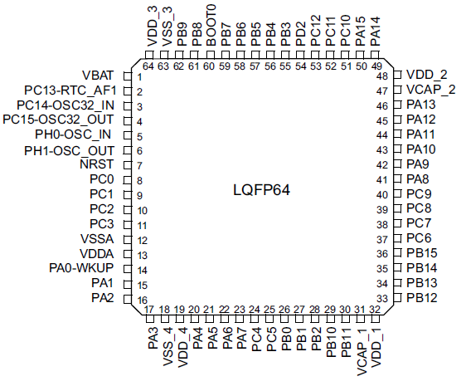
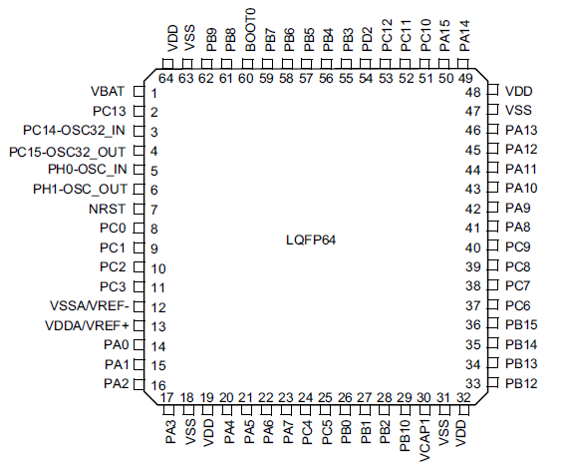


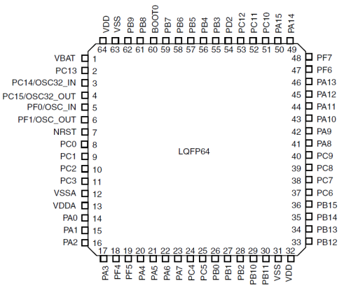
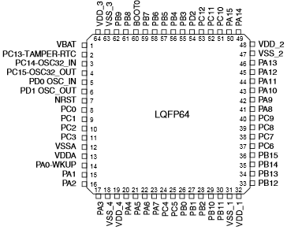
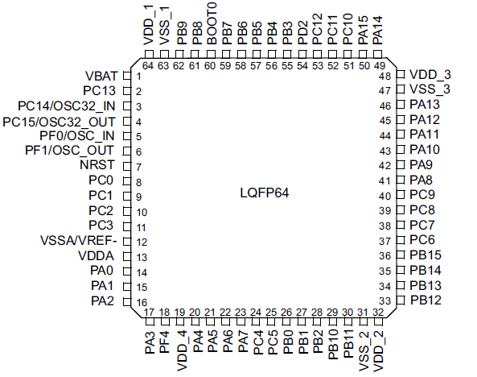



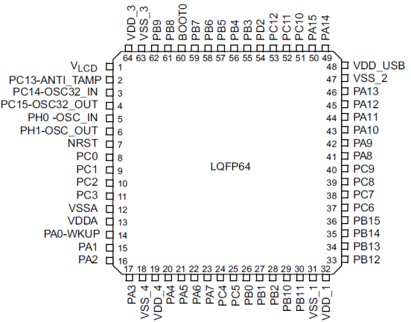
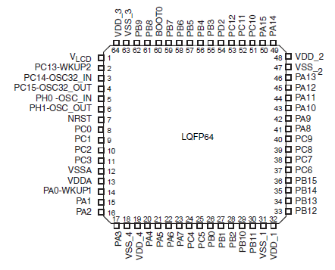

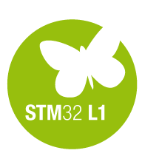
STM32 pin-to-pin compatibility(ex: LQFP64 )
Performance
Energy Efficiency
Mainstream
Over 550 pin-to-pin compatible devices
Ultra-low-power
CortexTM-M0/0+
CortexTM-M3
CortexTM-M4

Slide 5

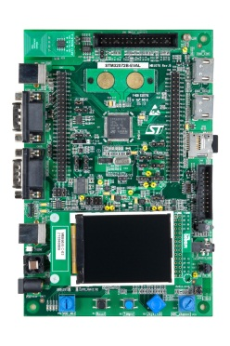
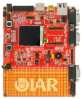
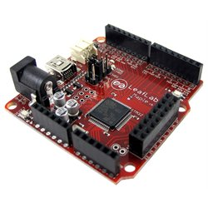
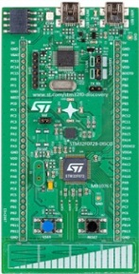
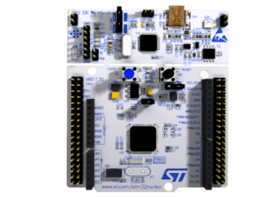
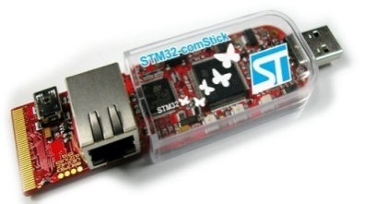

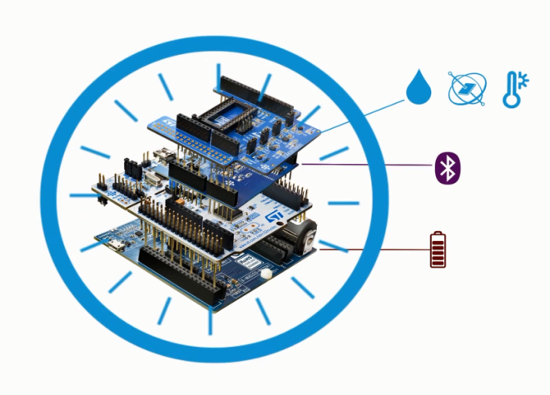







Broad Range of Development Tools
STM32 Nucleo
Discovery kits
Evaluation boards
3rd parties
Flexible prototyping
Key feature prototyping
Full feature evaluation
From full evaluation to open hardware
www.st.com/stm32nucleo
www.st.com/stm32discovery
STM32 Nucleo expansion boards
Specialized functionality add-on
Connectivity, Sensors…
www.st.com/x-nucleo
Notes:
Various types of development boards enable you to get started with the STM32 microcontrollers.
* The STM32 Nucleo boards provide an affordable and flexible way for anyone to try out new ideas and build prototypes with a wide choice of specialized expansion boards.
* The Discovery kits enable users to seamlessly exercise key features of STM32 products, while the Evaluation board exposes all MCU functionalities.
All these development boards include an integrated debugger/programmer as well as a comprehensive software library with examples that help developers to take davantage of STM32 capabilities.

Slide 6
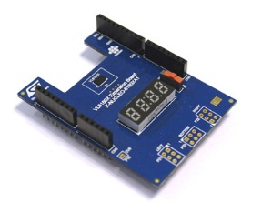
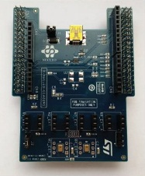
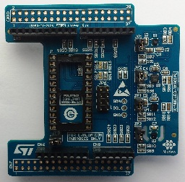
STM32 ODE
STM32 X-Nucleo Portfolio
Sensors Expansion Boards
Part Number | Marketing Status | Core Product | General Description
P-NUCLEO-6180X1 | Active | VL6180X | VL6180X Nucleo pack - NEW - Includes VL6180X Expansion board and STM32F401RE Nucleo
P-NUCLEO-6180X2 | Active | VL6180X | VL6180X Nucleo pack - NEW - Includes VL6180X Expansion board and STM32L053R8 Nucleo
X-NUCLEO-6180XA1 | Active | VL6180X | Proximity and ambient light sensor expansion board based on VL6180X for STM32 Nucleo
X-NUCLEO-CCA02M1 | Active | MP34DT01-M | Digital MEMS microphones expansion board based on MP34DT01-M for STM32 Nucleo
X-NUCLEO-IKS01A1 | Active | LSM6DS0; LIS3MDL; LPS25HB; HTS221 | Motion MEMS and environmental sensor expansion board for STM32 Nucleo
Proximity
Motion MEMS
Environmental Sensors
MEMS Microphones

Slide 7
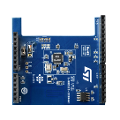
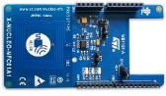
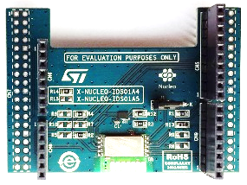
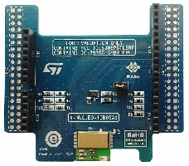
STM32 ODE
STM32 X-Nucleo Portfolio
Connectivity Expansion Boards
Part Number | Marketing Status | Core Product | General Description
X-NUCLEO-IDB04A1 | Active | BlueNRG; BALF-NRG-01D3 | Bluetooth low energy expansion board based on BlueNRG for STM32 Nucleo
X-NUCLEO-IDB05A1 | Evaluation | SPBTLE-RF;BlueNRG-MS;BALF-NRG-01D3 | Bluetooth Low Energy expansion board based on SPBTLE-RF module for STM32 Nucleo
X-NUCLEO-IDS01A4 | Active | SPSGRF-868 | Sub-1 GHz RF expansion board based on the SPSGRF-868 module for STM32 Nucleo
X-NUCLEO-IDS01A5 | Active | SPSGRF-915 | Sub-1 GHz RF expansion board based on the SPSGRF-915 module for STM32 Nucleo
X-NUCLEO-NFC01A1 | Active | M24SR64-YMN6T/2 | Dynamic NFC tag expansion board based on M24SR for STM32 Nucleo
Bluetooth Smart
SubGhz
NFC

Slide 8
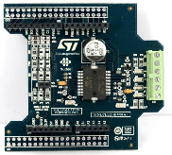
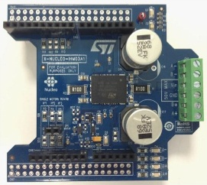
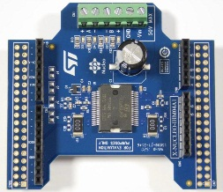
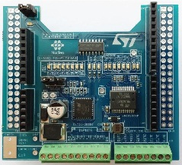
STM32 ODE
STM32 X-Nucleo Portfolio
Motor Control Expansion Boards
Part Number | Marketing Status | Core Product | General Description
X-NUCLEO-IHM01A1 | Active | L6474PD | Stepper motor driver expansion board based on L6474 for STM32 Nucleo
X-NUCLEO-IHM03A1 | Active | powerSTEP01 | High power stepper motor driver expansion board based on powerSTEP01 for STM32 Nucleo
X-NUCLEO-IHM04A1 | Active | L6206 | Dual brush DC motor driver expansion board based on L6206 for STM32 Nucleo
X-NUCLEO-IHM05A1 | Active | L6208 | Bipolar stepper motor driver expansion board based on L6208 for STM32 Nucleo
Stepper Motors
Brush DC
NFC
Input-Output Expansion Boards
Part Number | Marketing Status | Core Product | General Description
X-NUCLEO-PLC01A1 | Active | CLT01-38SQ7;VNI8200XP | Industrial input/output expansion board based on VNI8200XP and CLT01-38SQ7 for STM32 Nucleo

Slide 9
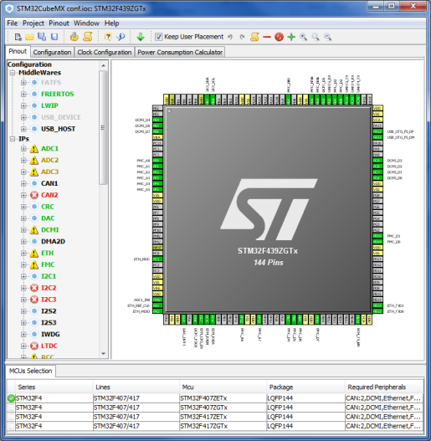
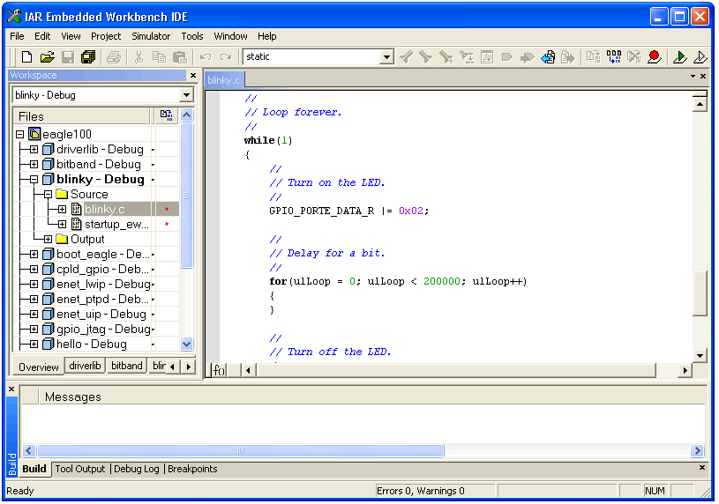
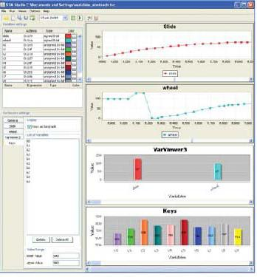

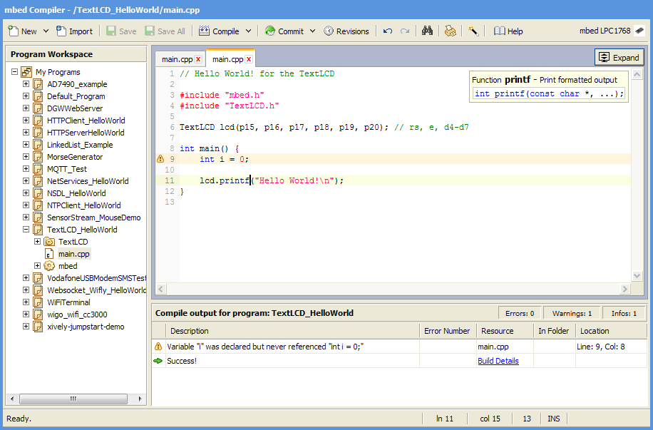








Comprehensive choice of IDEs
STM32CubeMX
Partners IDEs
STMStudio
Generate Code
Compile & Debug
Monitor
Free IDE

Slide 10
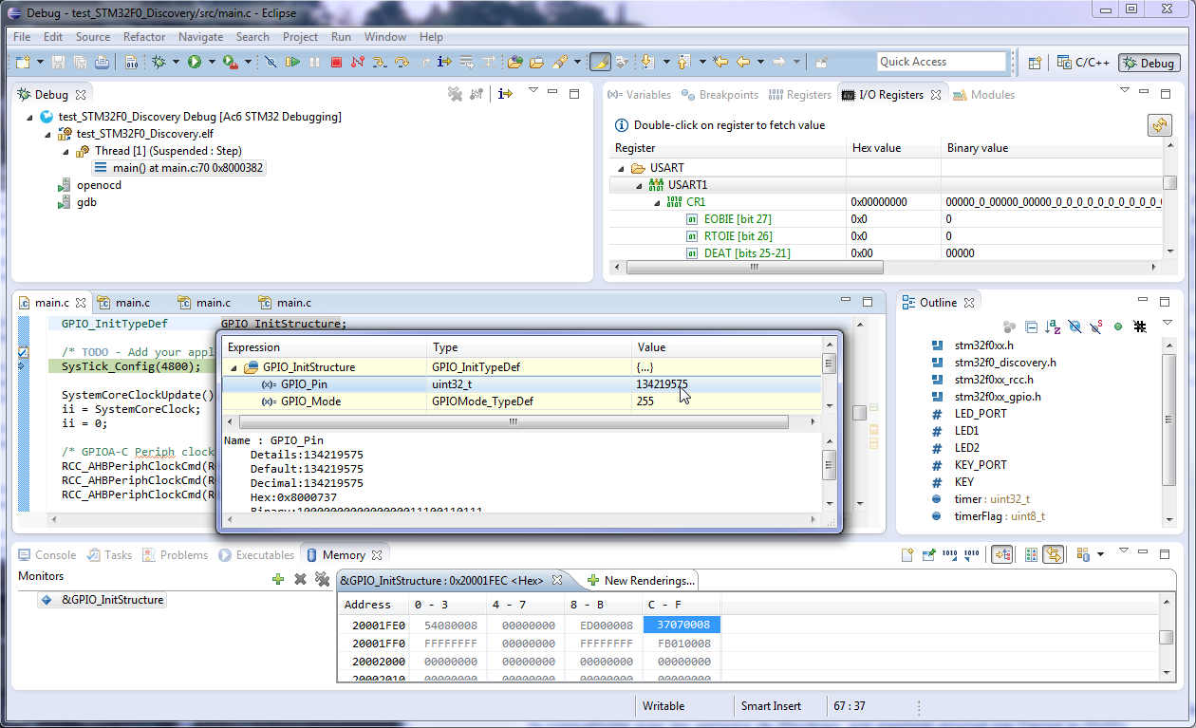
System Workbench for STM32
Free Eclipse-based flexible software development environment :
Covers the full range of STM32 mcus and associated boards (Nucleo, Discovery, Eval).
Comprehensive support for STM32 firmware (Standard Peripheral library or Cube HAL).
Customisation enabled through Eclipse plug-ins (SVN, EGit…).
Key features :
GCC C/C++ compiler.
GDB-based debugger.
ST-Link support.
Multi-OS support : Windows, Linux & OSX (Q2’2015).
No code size limit.
SW4STM32 project format will be supported by CubeMX.

Slide 11
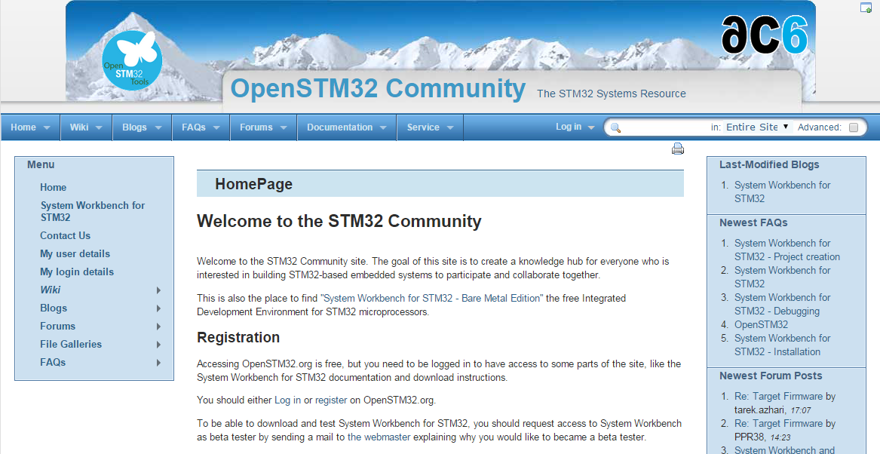
System Workbench for STM32
How to download SW4STM32 ?
Go to associated collaborative site at www.openstm32.org
Register to this site.
Get installation instructions at the Documentation > System Workbench page.
Proceed with immediate download of the toolchain.
Technical support :
Handled through the associated Openstm32 website.
Documentation, forum, blog, trainings are available to provide assistance to users.

Slide 12

CoIDE
Free Eclipse-based simplified software development environment:
Supports all STM32 mcus and Nucleo boards.
Supports STM32Cube firmware (HAL).
Download and Technical support available through collaborative site at www.coocox.org
Key features :
GCC C/C++ compiler.
GDB-based debugger.
No code size limit.
ST-Link support.
English and Chinese languages are supported.

Slide 13

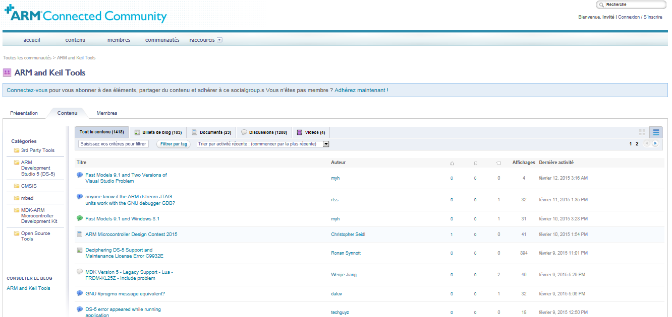
MDK-ARM
Comprehensive software development environment for Cortex-M devices :
Free version for ST supports all STM32F0 and STM32L0 mcus and associated boards (Nucleo, Discovery, Eval).
Comprehensive support for STM32 firmware (Std Peripheral library or Cube HAL).
Technical support available through the ARM Connected Community site at community.arm.com
Key features :
ARM C/C++ compiler.
uVision IDE, debugger and simulation environment.
CMSIS-compliant.
ST-Link support.
English, Chinese, Japanese, Korean languages are supported.
The setup of peripherals configured by CubeMX is directly exported to MDK.

Slide 14
Free MDK-ARM for ST
Free licenses for STM32 devices based on Cortex-M0/M0+ cores :
Applicable immediately to all STM32F0 and STM32L0 mcus.
PC-locked multi-year licenses.
No code size limit.
Multiple language support.
Technical support included.
Direct download from Keil website :
No limit of number of downloads by customer.
Direct access to configuration files for STM32 and associated boards.
Free access to MDK-ARM periodic updates.
How to get free MDK-ARM licenses for STM32F0 and STM32L0 ?
Go to Keil website at : www.keil.com/mdk-st
Download MDK-ARM toolchain.
Activate the free license using this Product Serial Number (PSN) : U1E21-CM9GY-L3G4L

Slide 15



Comprehensive choice of STM32 free IDEs
System Workbench
CoIDE
MDK-ARM
Q2’2015
Q2’2015
Free licenses for all STM32 microcontrollers
Free licenses for STM32F0 & STM32L0
Free access to all STM32Nucleo users

Slide 16



STM32 Embedded Software Offer - Overview
Abstraction Level
Virtual Machines
With partners
.Net, Java
IS2T, Oracle, Mountainer, .…
Mbed Core
« C » partners
Micrium, SEGGER,
HCC, ….
STM32Cube
Standard Peripheral Libraries
STM32Snippets
Portability Level
STM32 Device
-specific
f.i.: STM32F072
STM32 Series
-specific
f.i.: STM32F1
STM32 Family
-specific
Cortex-M based
MCUs
-specific
Any MCU
Beyond MCU
world
ST Offering. Free
Partners Offer

Slide 17

STM32Snippets
What is it ?
A collection of code examples, directly based on STM32 peripheral registers, available in documentation and as software bundles
Target Audience
low level embedded system developers, typically coming from an 8 bit background, used to assembly or C with little abstraction
Features:
Highly Optimized
Register Level Access
Small code expressions
Closely follows the reference manual
Debugging close to register level
Limitations:
Specific to STM32 devices, not portable directly between series
Not matching complex peripherals such as USB
Lack of abstraction means developers must understand peripheral operation at register level
Available (today) on STM32 L0 and F0 series
Portability | Optimization (Memory & Mips) | Easy | Readiness | Hardware coverage
 | +++ |  |  | +

Slide 18

Standard Peripheral Libraries (SPL)
What is it ?
Collection of C Libraries covering STM32 peripherals
Target Audience
Embedded systems developers with procedural C background. All existing STM32 customer base prior to the STM32Cube launch, willing to keep same supporting technology for future projects, and same STM32 series.
Features:
Average optimization, fitting lots of situations
No need for direct register manipulation
100% coverage of all peripherals
Easier debugging of procedural code
Extensions for complex middleware such as USB/TCP-IP/Graphics/Touch Sense
Limitations:
Specific to certain STM32 series.
No common HAL API prevents application portability between series
Middleware libraries may not be unified for each series
Doesn’t support forward STM32 series starting with STM32 L0 and F7
Portability | Optimization (Memory & Mips) | Easy | Readiness | Hardware coverage
++ | ++ | + | ++ | +++

Slide 19



STM32Cube - Embedded software
What is it ?
Full featured packages with drivers, USB, TCP/IP, Graphics, File system and RTOS
Set of common application programming interfaces, ensuring high portability inside whole STM32 family
User code
STM32Cube
Middleware
STM32Cube
STM32 Hardware abstraction layer
Target Audience
Embedded system developers with a strong structured C background. New customers looking for a fast way to evaluate STM32 and easy portability
Features:
High level and functional abstraction
Easy port from one series to another
100% coverage of all peripherals
Integrates complex middleware such as USB/TCP-IP/Graphics/Touch Sense/RTOS
Can work with STM32CubeMX tool on the PC to generate initialization code
Limitations:
May be challenging to low level C programmers in the embedded space.
Higher portability creates bigger software footprints or more time spent executing adaptation code
Not Available (today) on STM32 F1 series
Portability | Optimization (Memory & Mips) | Easy | Readiness | Hardware coverage
+++ | + | ++ | +++ | +++

Slide 20
ST Embedded software offer – Comparison
Offer | Portability | Optimization (Memory & Mips) | Easy | Readiness | Hardware coverage
STM32Snippets |  | +++ |  |  | +
Standard Peripheral Library | ++ | ++ | + | ++ | +++
STM32Cube | +++ | + | ++ | +++ | +++

Slide 21
ST Embedded software offer - Positioning
Abstraction Level
Libraries, released independently
STM32Cube Embedded Software packages
STM32Cube Middleware level
TCP/IP
RTOS
TCP/IP
USB
Host / Device
Gfx
FAT
File
Sys.
RTOS
Touch
USB
Host / Device
FAT
File
Sys.
Touch
Gfx
STM32Cube HAL
(Hardware Abstraction Layer)
Standard Peripheral Libraries
STM32Snippets
Portability Level
STM32 Device
-specific
f.i.: STM32F072
STM32 Series
-specific
f.i.: STM32F1
STM32 Family

Slide 22










Availability
Offer | Available for STM32
STM32Snippets | Now | N.A. | N.A. | N.A. | N.A. | N.A. | Now | N.A. | N.A.
Standard Peripheral Library | Now | Now | Now | Now | Now | N.A. | N.A. | Now | N.A.
STM32Cube | Now | Now | Now | Now | Now | June 15 | Now | Now | Sept 15

Slide 23
STM32Cube Ecosystem

Slide 24








STM32CubeTM Introduction
24
STM32CubeTM includes:
A configuration tool, STM32CubeMX generating initialization code from user choices
Firmware offering, delivered per series (like STM32CubeF4) with:
An STM32 Abstraction Layer embedded software: STM32Cube HAL
A consistent set of Middleware: RTOS, USB, TCP/IP, Graphics, …
Initialization Code generation based on user choices
STM32CubeMX
STM32Cube HAL: Portable API within all series - Middleware stacks when applicable: RTOS, USB, TCP/IP, Graphics, …
STM32CubeL0
STM32CubeF4
STM32CubeL1
STM32CubeF0
STM32CubeF2
STM32CubeF1
STM32CubeF3

Slide 25
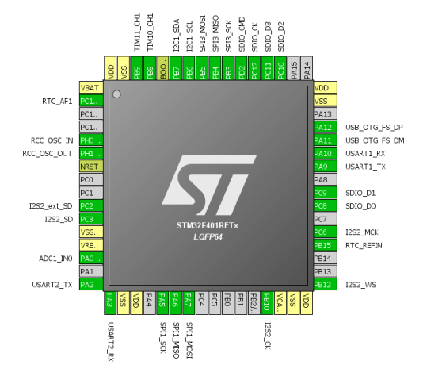
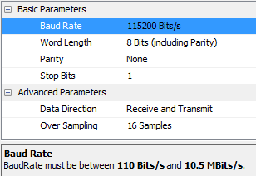


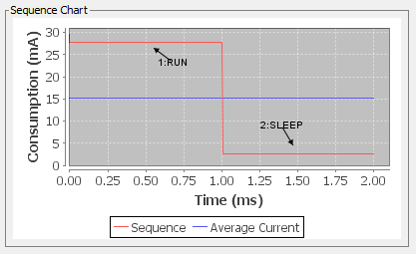
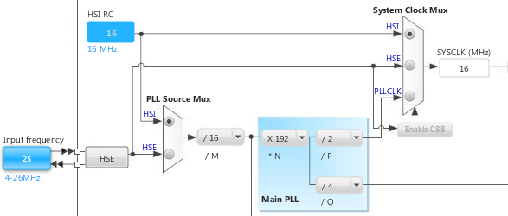
STM32CubeMX
25
Pinout Wizard
Peripherals & Middleware
Wizard
Power Consumption
Wizard
Clock Tree wizard

Slide 26

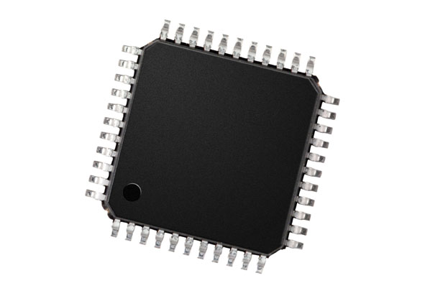
STM32CubeMX
26
Generates Initialization C Code
based on user choices !

Slide 27
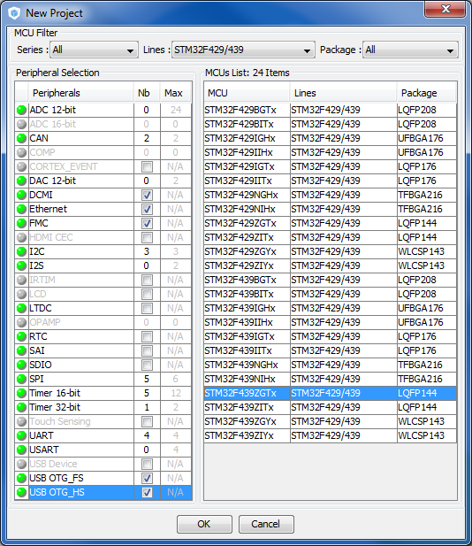
STM32CubeMX: MCU Selector
Filter by:
Series
Line
Package
Peripherals

Slide 28
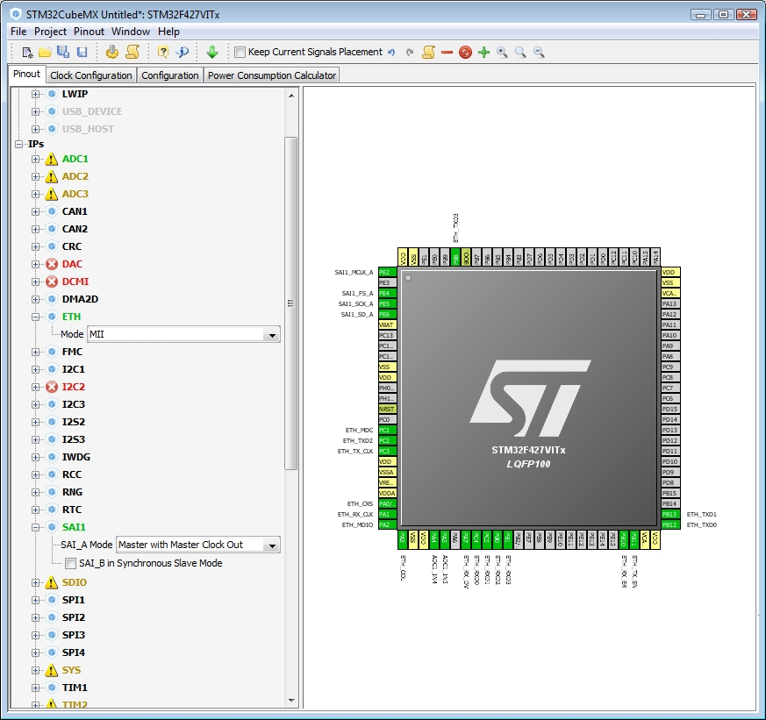
STM32CubeMX: Pin-out configuration
Pinout from:
Peripheral tree
Manually
Automatic signal remapping
Management of dependencies between peripherals

Slide 29
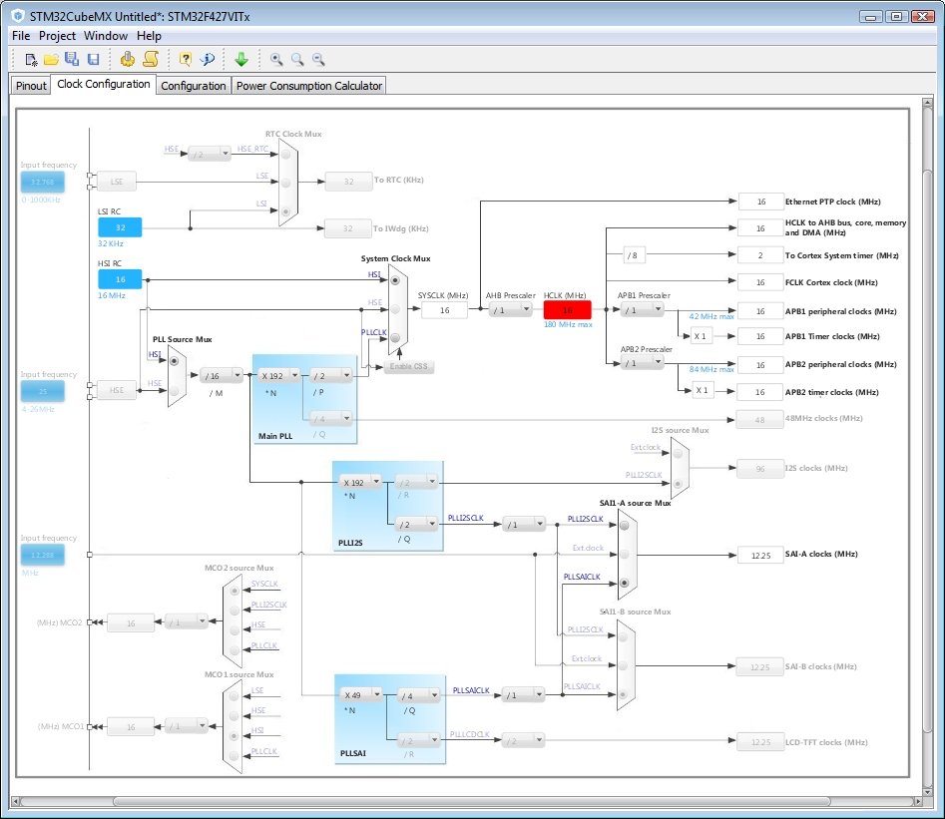
STM32CubeMX: Clock tree
Immediate display of all clock values
Management of all clock constraints
Highlight of errors

Slide 30
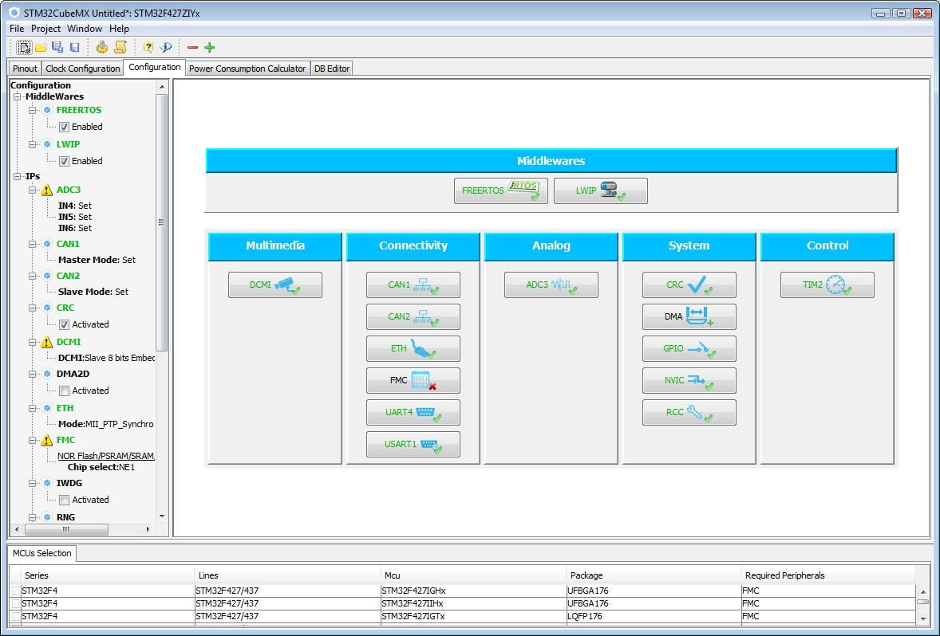
STM32CubeMX: Peripheral configuration
Global view of used peripherals and middleware
Highlight of configuration errors
Manage:
GPIO
Interrupts
DMA

Slide 31
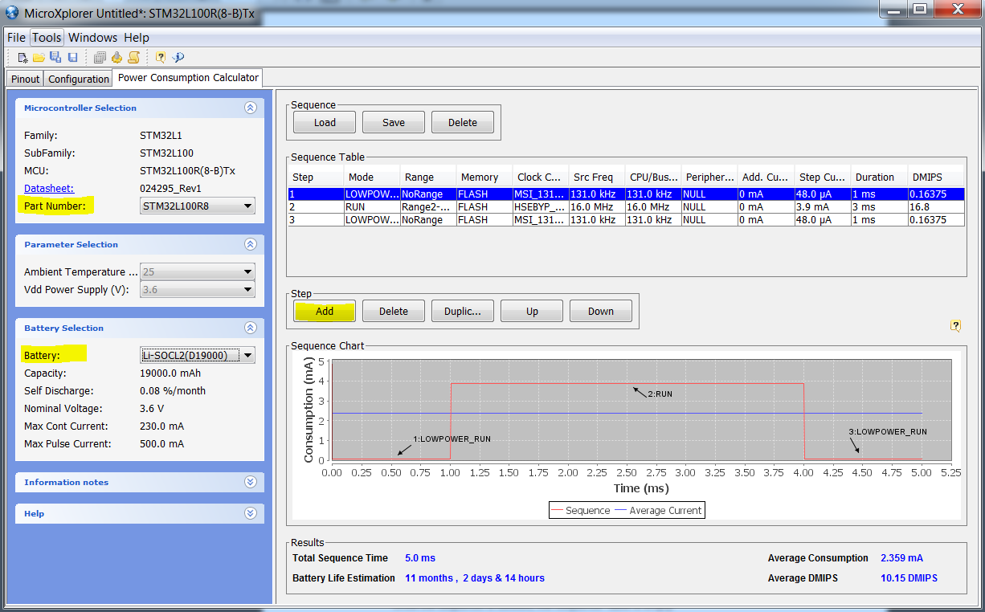
Power consumption calculator
Power step definitions
Battery selection
Creation of consumption graph
Display of
Average consumption
Average DMIPS
Battery lifetime

Slide 32
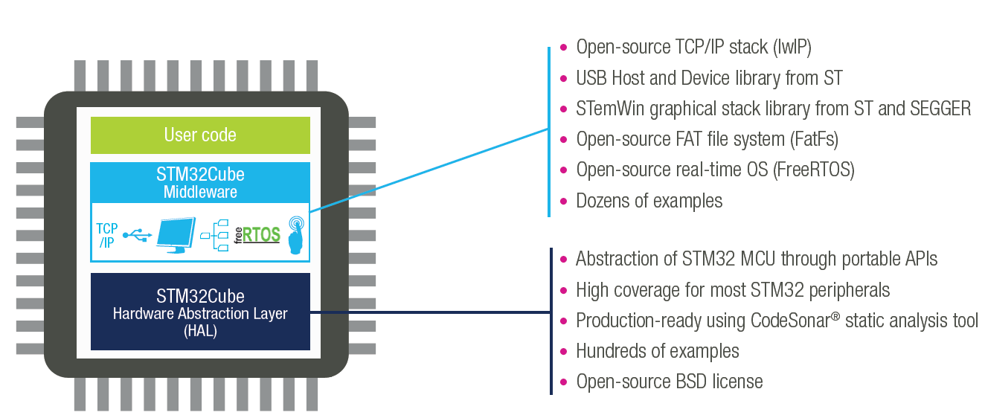
STM32Cube Supporting all STM32 MCUs
Generate your configuration code with the STM32Cube and you can focus on your added-value software !
4 configuration wizards: pinout, clock, peripherals & middleware, power consumption
Portable Hardware Abstraction layer, from series to others
Middleware with RTOS, USB, TCP/IP, File System, Graphics , Touch sensing…
www.st.com/stm32cube

Slide 33
STM32 ST-LINK Utility

Slide 34
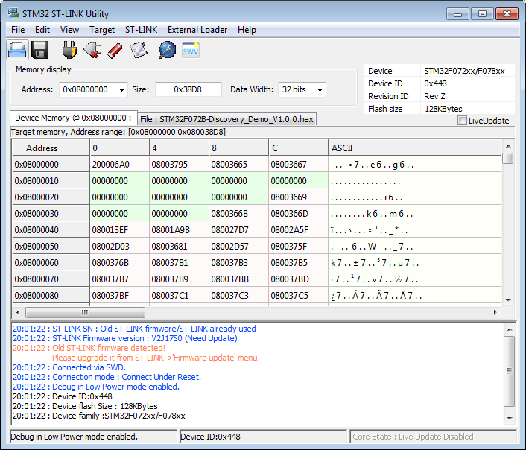
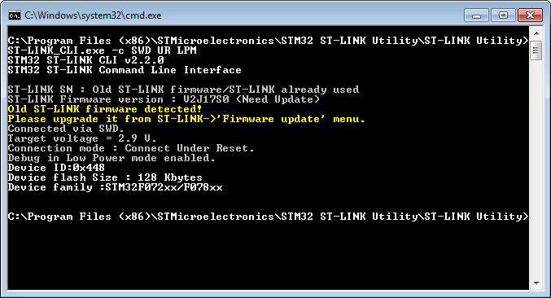
STM32 ST-LINK Utility
Standalone software tool allows in-system programming of STM32 devices
Supports Binary, Hex and Motorola S-Record file formats
Allows programming option bytes
Supports ST-LINK/V2
Command line version available for usage with batch files and small quantity production
ST-LINK_CLI.exe
Supports multiple ST-LINK/V2 connected to same PC
User manual UM0892

Slide 35
ST Visual Programmer

Slide 36
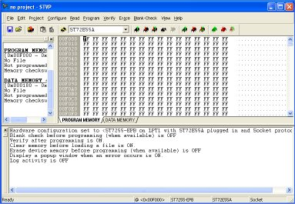
STVP
Free software that supports Motorola S19 and Intel HEX formats
Load, Edit and Save executable and/or data files generated by the Assembler/Linker or C compilers
Erase, Program, View and Verify device Flash memory contents
Project mode to automate all configuration and programming tasks
Programming Toolkit with C/C++ source files for creating a programming application based STVP
STVP supports microcontroller programming via a complete range of hardware development tools and dedicated programmers, including:
ST-LINK in-circuit debugger/programmer for STM8 and STM32

Slide 37
STM32 FLASH LOADER DEMONSTRATOR

Slide 38
FLASH LOADER DEMONSTRATOR
Illustrate the System Memory boot loader capabilities
The Flash loader demonstrator is designed to work with all STMicroelectronics devices that support the system memory boot mode UART protocol

Slide 39
DFUSE

Slide 40
DFUSE
Perform the upgrade operation with some requires, such as:
Product identifier
Vendor identifier
Firmware version
Alternate setting number (Target ID) of the target to be used,
These information makes the upgrade targeted and more secure.
To add this information, a new file format should be used, to be called DFU file format

Slide 41
STMSTUDIO

Slide 42
STMSTUDIO
STM Studio is a non-intrusive tool, preserving the real-time behavior of applications.
STM Studio perfectly complements traditional debugging tools to fine tune applications.
It is well suited for debugging applications which cannot be stopped, such as motor control applications.
Connects to any STM32 via ST-LINK (JTAG or SWD protocols), reads on-the-fly (non intrusive) variables from RAM while application is running

Slide 43
FOC SDK

Slide 44
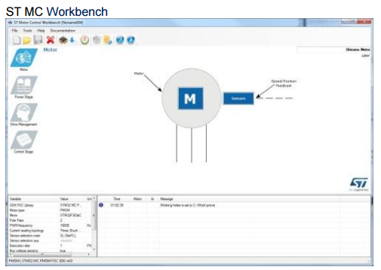
STMSTUDIO
ST’s STM32 offers the performance of the industry-standard Cortex®-M core at the service of vector (or field-oriented) control (FOC) algorithms, widely used in high-performance drives.
The STM32 PMSM FOC SDK (STSW-STM32100), which includes the PMSM FOC FW library and ST MC Workbench, allows the user to evaluate the STM32 performance in applications driving single or dual Field Oriented

Slide 45




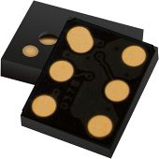
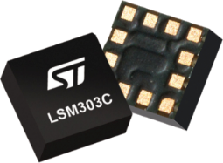







free SW licensing program
Unleashing the power of embedded software with algorithms and complete demonstrators for the Internet of Things.
Bring your ideas to now!
Notes:
This presentation will introduce the open.Audio free software licensing program.
Open.Audio is part of the ST Open Software Expansion initiative (OSX).
The Open Software Expansion (OSX) development suite offers drivers, middleware and application software to jump start your STM32 design with ST products like MEMS, Bluetooth low energy, environmental sensors, etc. It enables fast prototyping using the STM32 Open Development Environment with leading-edge components that can quickly be transformed into final designs.
The Open Software Expansion environment is made up of several free libraries:
• Open.MEMS: sensor fusion library for STM32 platform
• Open.RF: BlueNRG Bluetooth low energy library for the most commonly used BT smart profiles
• Open.Audio: embedded audio libraries and application software
It also includes implementation examples in the Open.Framework section. The BlueMicrosystem1 expansion software package uses a Bluetooth low energy (BlueNRG) network processor for communication and includes complete middleware to build applications using pressure, temperature and humidity sensors as well as motion sensors (MEMS).
Start your design today with our Open Software Expansion development suite.

Slide 46














STM32 ODE Nucleo and X-Nucleo
The building blocks
Your need
Our answer
Accelerometer, gyroscope
Sense
Inertial modules, magnetometer
DATA COLLECT
Pressure, temperature, humidity, UV
Proximity, microphone
Bluetooth LE, Sub-GHz radio
Connect
DATA TRANSMIT
NFC, Wi-Fi, GNSS
Audio amplifier
Translate
DATA ACCESS
Touch controller
Operation Amplifier
Stepper motor driver
Move / actuate
DATA CREATE
DC & BLDC motor driver
Power
DATA POWER
Energy management & battery
General purpose microcontrollers
Process
DATA PROCESS
STM32 Nucleo
Nucleo Expansion Boards
Secure microcontrollers
Software

Slide 47
STM32 M0 Overview
Cortex Architecture Overview
ARM Cortex Interrupt Overview
Debug System Overview

Slide 48
ARM Cortex-M0 Architecture Overview

Slide 49
STM32 Cortex-M0 implementation
Cortex-M0 components
Cortex-M0 processor
SLEEP
Nested Vectored Interrupt Controller (NVIC)
Cortex-M0 processor core
DEBUG
IRQs
Breakpoint Unit (BPU)
+
Data Watchpoint Trigger (DWT)
SysTick
Timer
3-stage pipeline
Debugger Interface
Debug Access Port (DAP)
BUS MATRIX
(1)
Serial Wire Debug (SWD)
AHB-Lite interface to system

Slide 50

Memory map overview
4GB linear memory space
No paging/banking
All locations always accessible by the SW
Supports 8/16/32-bit data
0xFFFFFFFF
(XN)
System components
and debug
System region
0xE0000000
(XN)
Device region
Off chip peripherals
0xA0000000
RAM region
Off chip memory
0x60000000
(XN)
Peripheral region
Peripherals
0x40000000
SRAM region
SRAM
0x20000000
CODE region
Program flash
0x00000000
Standard across all Cortex-M implementations
Notes:
50
Straight forward memory map

Slide 51
Core Registers
r0
All registers are 32-bit wide
Instructions exist to efficiently support packed 8/16/32-bit data in memory
13 general purpose registers
Registers r0 – r7 (Low registers)
Registers r8 – r12 (High registers)
Only 3 special registers (MRS, MSR)
Stack Pointer (SP) – r13
Link Register (LR) – r14
Program Counter (PC) – r15
Program Status Register
(Application / Interrupt / Execution)
r1
r2
r3
r4
r5
r6
r7
r8
r9
r10
r11
r12
r13 (SP)
r14 (LR)
r15 (PC)
PSR
Notes:
The same as ARM7TDMI and all other ARM processors
Instructions exist to efficiently support packed 8/16/32-bit data in memory
R0-R7: Accessible to all instructions
Registers R8-R12 : Accessible to a few 16-bit / all 32-bit instructions
R13 is the stack pointer
R14 is the link register
R15 is the program counter
xPSR (Program Status Register)
Not Explicitly accessible
Saved to the stack on an exception
Subsets available as APSR, IPSR
Two stack pointers – main stack pointer (used after reset and in exception handlers) and process stack pointer (can be used only in thread mode)

Slide 52
Stack Pointer and Stacks
r0
r1
Only in Thread Mode !
r2
r3
r4
31
2
1
0
r5
r6
CONTROL register
r7
Active stack pointer
r8
r9
r10
r11
Main Stack Pointer
r12
0
1
r13 (SP)
Process Stack Pointer
r14 (LR)
r15 (PC)
PSR
RTOS

Slide 53
Processor modes
Process Stack
/
Main Stack
(default)
RESET
STATE
THUMB STATE
Thread Mode
Normal code execution
Exception return
DEBUG STATE
Debug
operations
Handler Mode
Exception handler execution
Exception request
LOCKUP STATE
Exception request
Main Stack

Slide 54
Exception Model – States
Inactive
NOT Pending/Active
Pending
Waiting to be serviced by the processor
On Interrupt request generated by a peripheral or from software
Active
Actually serviced exception state
More exceptions can be active at a time
Active and pending
Exception is being serviced, but another request from the same source came already

Slide 55
ARM Cortex Interrupt Overview

Slide 56
Exception Model – Types and Priorities
No. | Exception Type | Priority | Type of Priority | Descriptions
1 | Reset | -3 (Highest) | fixed | Reset
2 | NMI | -2 | fixed | Non-Maskable Interrupt
3 | Hard Fault | -1 | fixed | Default fault if other handler is not implemented
4-10 | Reserved | N.A. | N.A.
11 | SVCall | Programmable | settable | Supervisor call (SVC)
12-13 | Reserved | N.A. | N.A.
14 | PendSV | Programmable | settable | Request for System-Level Service
15 | SYSTICK | Programmable | settable | System Tick Timer
16 | Interrupt #0 | Programmable | settable | External Interrupt #0
…… | ………………….. | ……………….. | settable | …………………..
47 | Interrupt#31 | Programmable | settable | External Interrupt #31
4 priority levels
Notes:
On ARM-v7M MemManage, UsageFault and BusFault exceptions with
support for escalation to HardFault.
2 priority bits

Slide 57
Interrupt Entry and Return
Interrupt handling is micro-coded
→ No instruction overhead
Entry (“Stacking”)
Processor state automatically saved to the stack over the bus
{PC, xPSR, R0-R3, R12, LR}
What about the other registers?
Then, ISR ready to start executing as soon as stack PUSH complete
Exit (“Unstacking”)
Processor state is automatically restored from the stack
Then interrupted instruction is executed upon completion of stack POP
Notes:
- The Interrupt Service Routine (ISR) generally must:
- Clear the interrupt source (in peripheral)
- Do the required interrupt work
- Return from interrupt

Slide 58
Preemption
“Interruption of the exception handler”
Depending on the priority
If higher priority exception request comes while another lower priority exception handler is executing
→ the higher priority exception can preempt the lower priority exception handler
Such exceptions are called nested exceptions

Slide 59
Exception Response
Standard exception latency is 16-cycles
The latency from processor clock cycle time when the exception is asserted to the first instruction of the exception handler execution
0 memory wait states
Can be reduced by the following two mechanisms:
Tail Chaining
If exception request exists or occurs just as another exception handler returns
→ Stacking process can be skipped
Late arriving (Late arrival)
If higher priority exception request occurs during lower priority exception stacking process
→ Higher priority exception handler is called right after the stacking finishes

Slide 60
Interrupt Response – Tail-Chaining
IRQ1
Highest
IRQ2
42 CYCLES
ARM7
Interrupt handling in assembler code
PUSH
ISR 1
POP
PUSH
ISR 2
POP
26
16
26
16
Tail-chaining
Cortex-M0
Interrupt handling in HW
PUSH
ISR 1
ISR 2
POP
Saving in Clock Cycles
16
6
16
ARM7
26 cycles from IRQ1 to ISR1 entered
Up to 42 cycles if LSM
42 cycles from ISR1 exit to ISR2 entry
16 cycles to return from ISR2
Cortex-M0
16 cycles from IRQ1 to ISR1 entered
6 cycles from ISR1 exit to ISR2 entry
16 cycles to return from ISR2
Notes:
Tail-chaining is back-to-back processing of exceptions without the overhead of state
saving and restoration between interrupts. The processor skips the pop of eight registers
and push of eight registers when exiting one ISR and entering another because this has
no effect on the stack contents.
The processor tail-chains if a pending interrupt has higher priority than all stacked
exceptions.
On cortex-M3 the push takes only 12 cycles because we have I and S bus than can be pushed fetched on same time
Here 12 cycles for context saving, then 4 cycles for reading the vector table…

Slide 61
Interrupt Response – Late Arriving
IRQ1
Highest
IRQ2
ARM7
PUSH
PUSH
ISR 1
POP
ISR 2
POP
26
26
16
16
Cortex-M0
PUSH
ISR 1
ISR 2
POP
16
6
16
Tail-Chaining
Cortex-M0
Stack push to ISR 2 is interrupted
Stacking continues but new vector address
is fetched in parallel
Late-arrival to ISR1 entry will depend
of the PUSH status, then 4 cycles
will be necessary to read the vector table.
Tail-chain into ISR 2
ARM7
26 cycles to ISR2 entered
Immediately pre-empted by IRQ1 and
takes a further 26 cycles to enter ISR 1.
ISR 1 completes and then takes 16
cycles to return to ISR 2.

Slide 62
NVIC – Vector Table
Vector Table starts at location 0
In the code section of the memory map
Vector Table contains addresses (vectors)
of exception handlers and ISRs
Not instructions
Table size (in words) is = number of IRQ inputs + 16
Minimum size ( case of 1 IRQ) : 17 words
Maximum size ( case of 32 IRQs) 48 words
Main stack pointer initial value in location 0
Set up by hardware during Reset
Vector Table can not be relocated
The vector table is always seen at address 0x00000000,
Different Boot option or memory remap function, allow user to alias at this direction, SRAM, FLASH or System Memory
Address | Vector
0x00 | Initial Main SP
0x04 | Reset
0x08 | NMI
0x0C | Hard Fault
0x10-0x28 | Reserved
0x2C | SVCall
0x30-0x34 | Reserved
0x38 | PendSV
0x3C | Systick
40 | IRQ0
… | More IRQs
Notes:
Vector Table Offset Register (VTOR) is not available on Cortex-M0; It is available on Cortex-M0+, M3 and M4. It allows you to dynamically relocate vector table, and is useful for implementing bootloaders and also for running interrupt code from RAM during Flash Write/Erase without any stall on devices that do not have dual-bank Read-While-Write capability.

Slide 63
Debug System Overview

Slide 64

Debug subsystem
Breakpoint Unit (BPU)
Instruction Comparison
Data Watchpoint (DWT)
Data Comparison
Debug Access Port (DAP)
Background access to all memory and registers
Interface to outside debug host via SWD
Cortex-M0
BPU
DAP
DWT
M0 Core
BUS
ROM
SRAM
Peripherals
DBGMCU

Slide 65
Debug – Main features
Break on instruction fetch (PC comparison) or data access data match
Serial Wire interface (SWD), only two pins!
Break point unit (BPU) – 4 breakpoints
Core is stopped on a given instruction fetch
Data watchpoint trigger (DWT) – 2 watchpoints
data address and PC sampling
Additional DBGMCU peripheral:
low-power modes
timers, watchdog and I²C behavior during breakpoint
device ID code
V_{DD}
SWDIO
SWCLK
V_{SS}
Note: on STM32F0x2 devices, SWDIO pull-up is connected to VDDIO2

Slide 66
Debug – Device ID detection
2 registers which can be used to check device type and also its unique ID
MCU device ID code (DBGMCU):
Unique device ID register (UID)
96-bit register
X,Y coordinates on the wafer + Lot number + Wafer number
31 | 30 | 29 | 28 | 27 | 26 | 25 | 24 | 23 | 22 | 21 | 20 | 19 | 18 | 17 | 16 | 15 | 14 | 13 | 12 | 11 | 10 | 9 | 8 | 7 | 6 | 5 | 4 | 3 | 2 | 1 | 0
Revision ID |  |  |  |  |  |  |  |  |  |  |  |  |  |  |  | Division ID |  |  |  | Device ID
Revision of the device
ST division (0x6)
0x440
Notes:
Note: 96-bit Unique ID is not available in Value Line devices (STM32F0x0)

Slide 67
Architecture & Peripherals

Slide 68
System Architecture
Multiply possibilities of bus accesses to SRAM, Flash, Peripherals, DMA
BusMatrix added to allow parallel access
Efficient DMA and Rapid data flow
Direct path to SRAM through arbiter, guarantees alternating access
Von Neumann + BusMatrix allows Flash execution in parallel with DMA transfer
Increase Peripherals Speed for better performance
Advanced Peripheral bus (APB) architecture up to 48MHz
➔ Allows to optimize use of peripherals (18MBits/s SPI, 6Mbps USART, 48MHz GP-Timer, 12MHz toggling I/Os)
AHB
Flash I/F
Slave 3
FLASH
CORTEX-M0
Master 1
System
AHB
SRAM
Slave 1
Buses are not overloaded
with data movement tasks
BusMatrix
AHB
GPIO A, B ,C, D, E, F
GP-DMA
Master 2
DMA
AHB2GPIO
Slave 4 Bridge
AHB
RCC, CRC, Touch
Sensing controller (TSC)
AHB2APB
APB
SYSCFG, TIMs, WWD, IWWD, RTC,
I2Cs, USARTs, SPI/I2Ss, HDMI-CEC,
BxCAN, USB, DBGMCU
Arbiter
Slave 2 Bridges
Notes:
Several AHB subsystems
Dedicated AHB to GPIO
Each peripheral can be reset independently on APB

Slide 69
Boot Modes
69
Boot modes
Depending on the Boot configuration, Embedded Flash memory, System memory or Embedded SRAM memory
is aliased at @0x00. Even when aliased, these memories are still accessible from their original memory space.
The boot configuration is defined with BOOT0 pin, nBOOT1 bit, nBOOT0 bit and BOOT_SEL bit from USER option byte.
BOOT Mode Selection |  |  |  | Boot Mode | Aliasing
nBOOT1 bit | BOOT0 pin | BOOT_SEL bit | nBOOT0 bit
X | 0 | 1 | X | User Flash | User Flash is selected as boot space
1 | 1 | 1 | X | System memory | System Memory is selected as boot space
0 | 1 | 1 | X | Embedded SRAM | Embedded SRAM is selected as boot space
X | X | 0 | 1 | User Flash | User Flash is selected as boot space
1 | X | 0 | 0 | System memory | System Memory is selected as boot space
0 | X | 0 | 0 | Embedded SRAM | Embedded SRAM is selected as boot space
Notes: Field in blue are availables on STM32F04x only. The boot pin can be disabled through Option bits, offering an additional GPIO for users.
System memory : contains the Bootloader used to re-program the FLASH through USART1 (same pins configuration as for STM32 products).
Boot from SRAM : The relocation of the vector table is not allowed on the Cortex M0. When Booting from SRAM, System memory or User Flash, the vector table will be aliased at direction 0x00000000
Notes:
The bytes are treated in memory as being in Little Endian format.
Even when aliased in the boot memory space, the related memory (FLASH or SRAM) is still accessible at its original memory space.
- Only 12 bytes (6 + 6 complemented) are used as option bytes
System memory: contains the Boot Loader is used to re-program the FLASH through the USART.
The Boot Loader is programmed by ST during production.
RAM remapping feature is particularly useful for managing Reset vectors and routines, you can copy them to SRAM, modify and access them even when Flash is not available (i.e. during Flash programming or erasing).
-Parity check
The data bus width is 36 bits because 4 bits are available for parity check (1 bit per byte) in
order to increase memory robustness, as required for instance by Class B or SIL norms.
The parity bits are computed and stored when writing into the SRAM. Then, they are
automatically checked when reading. If one bit fails, an NMI is generated. The same error
can also be linked to the BRK_IN Break input of TIMER1, with the SRAM_PARITY_LOCK
control bit in the SYSCFG configuration register 2 (SYSCFG_CFGR2). The SRAM Parity
Error flag (SRAM_PEF) is available in the SYSCFG configuration register 2
(SYSCFG_CFGR2).

Slide 70
Flash Read Protection (FLASH)
Level 1
RDP ≠ 0xCC
RDP ≠ 0xAA
BLOCKED access to memory from SRAM, system memory and SWD
Remove of readout protection still possible after full erase of the memory and its blank verification
Level 2 RDP=0xCC
Level 0 RDP=0xAA
SWD fuse
SWD disabled, System memory disabled
User settings protected
No un-protection possible → IRREVERSIBLE!!!
Full access to memory from SRAM, system memory and SWD
No readout protection

Slide 71
Flash Protections (6/6)
Access status versus protection level and execution modes :
Area | Protection level | User execution |  |  | Debug, boot from RAM or boot from system memory (loader)
 |  | Read | Write | Erase | Read | Write | Erase
Main memory | 1 | Yes | Yes | Yes | No | No | No
 | 2 | Yes | Yes | Yes | N/A | N/A | N/A
System memory | 1 | Yes | No | No | Yes | No | No
 | 2 | Yes | No | No | N/A | N/A | N/A
Option bytes | 1 | Yes | Yes | Yes | Yes | Yes | Yes
 | 2 | Yes | Yes | No | N/A | N/A | N/A
Backup registers | 1 | Yes | Yes | N/A | No | No | N/A
 | 2 | Yes | Yes | N/A | N/A | N/A | N/A
Notes:
Option byte in user mode level 2 : cannot be erase and RDP cannot be programmed.
Yellow yes lvl1: The main flash memory is erased when the RDP option byte is programmed with all levels protection disabled
Yellow yes lvl2: All option bytes can be programmed, except the RDP byte

Slide 72
Power Supply
Power Supply Schemes
VDD = 2.0 to 3.6 V: External Power Supply for I/Os and the internal regulator.
On STM32F0x8 (regulator off part), VDD = 1.8V(+/- 8%): An external regulator must be used.
VDDA = 2.0 to 3.6 V: External Analog Power supplies for ADC,DAC, Reset blocks, RCs and PLL.
➔ ADC or DAC working only if VDDA >=2.4V
VDDIO2 = 1.65V to 3.6V: External Power Supply for some GPIOs which then have a flexible voltage versus the VDD, and Power supply for the USB Transceiver.
VBAT = 1.65V to 3.6 V: For Backup domain when VDD is not present.
Power pins connection:
VDD and VDDA can be provided by a separated power supply source.
VSS and VSSA must be tight to ground
V_{DDA} domain
A/D converter
D/A converter
COMP
Temp. sensor
Reset block
PLL
V_{DDA}
V_{SSA}
V_{DDIO2} domain
V_{DDIO2}
V_{DDIO2} I/O Rings
USB Tranceiver
V_{SS}
V_{DD} domain
V₁₈ domain
VDDIO1 I/O Rings
Core
Memories
Digital
peripherals
STANDBY circuitry
(IWDG, RTC, LSE
crystal 32K osc,
RCC CSR )
V_{SS}
V_{DD}
Voltage Regulator
Low Voltage Detector
Backup domain
LSE crystal 32K osc
BKP registers
RCC BDCR register
RTC
V_{BAT}
Note: The voltage regulator (outlined in blue on the scheme) is not present on the STM32F0x8 products.

Slide 73
POR, PDR Circuitry (PWR)
VDD and VDDA
Two Integrated POR / PDR circuitries guarantees proper product reset when voltage is not in the product guaranteed voltage range (2V to 3.6V)
No need for external reset circuit
POR and PDR have a typical hysteresis of 40mV
The external power supply VDDIO2 can also be monitored. A comparator is embedded between its voltage and the Vrefint, triggering an external interrupt if its drop below this voltage.
Vtrh
POR
Vtrl
40mv hysteresis
PDR
Tempo 2.5ms
Reset
Vtrl min 1.8V / Vtrh max 2V

Slide 74
PVD Circuitry (PWR)
Programmable Voltage Detector
Enabled by software
Monitor the VDD power supply by comparing it to a threshold
Threshold configurable from 2.1V to 2.9V by step of 90mV
Generate interrupt through EXTI Line16 (if enabled) when VDD < Threshold and/or VDD > Threshold
➔ Can be used to generate a warning message and/or put the MCU into a safe state
VDD
PVD Threshold
100mv hysteresis
PVD
Output

Slide 75
RTC Domain (PWR)
RTC Domain contains
Low power calendar RTC (Alarm, periodic wakeup from Stop/Standby)
20 Bytes Data RTC registers
Separate 32kHz Osc (LSE) for RTC
RCC BCSR register: RTC clock source selection and enable + LSE config
➔ Reset only by RTC domain RESET
VBAT independent voltage supply
Automatic switch-over to VBAT when VDD goes lower than PDR level
No current sunk on VBAT when VDD present
Auto-wakeup feature on STM32F07x devices.
Tamper event detection: resets all user backup registers
TimeStamp event detection.
Backup Domain
V_{BAT}
RCC BDSR
reg
32KHz OSC
(LSE)
power switch
Wakeup
Logic
IWWDG
V_{DD}
RTC + 20 Bytes Data
RTC_TAMPx

Slide 76
Reset and Clock Control (RCC)
System Clock (SYSCLK) sources:
HSE (High Speed External osc) 4MHz to 32MHz, can be bypassed by user clock
HSI (High Speed Internal RC): factory trimmed internal RC oscillator 8MHz +/- 1%
HSI48 (High Speed 48 MHz RC): In application trimmed through CRS. F04/7 only
internal PLL x2, x3, .. x16 (16MHz min. output freq.)
Additional clock sources:
LSI (Low Speed Internal RC): ~40kHz internal RC
LSE (Low Speed External oscillator): 32.768kHz, can be bypassed by user clock
configurable driving strength (power/robustness compromise)
HSI14 (High Speed Internal RC 14MHz): dedicated oscillator for ADC
Clock-out capability on the MCO for all sources.
Clock Security System (CSS) to switch to backup clock in case of HSE clock failure & Clock Recovery System to monitor the 48MHz oscillator
RTC Clock sources: LSE, LSI and HSE clock divided by 32
USART, I2C & CEC have multiple possible clock sources

Slide 77
RESET Sources
System RESET
Resets all registers except some RCC registers and Backup domain
Sources
Low level on the NRST pin (External Reset)
WWDG end of count condition
IWWDG end of count condition
A software reset (through NVIC)
Low power management reset
Option byte loader reset (FORCE_OBL bit)
V_{DD}
External RESET
R_{PU}
Filter
SYSTEM RESET
NRST
WWDG RESET
PULSE
GENERATOR
(min 20µs)
IWWDG RESET
Software RESET
Low power management RESET
Option byte loader RESET
Power RESET
Standby exit
POR/PDR
Power RESET
Resets all registers except the Backup domain
Sources
Power On/Power down Reset (POR/PDR)
Exit from STANDBY
Backup domain RESET
Resets in the Backup domain: RTC registers + Backup Registers + RCC_BDCR register
Sources
BDRST bit in RCC_BDCR register
POWER Reset
Notes:
New:
pullup control
Option byte loader reset

Slide 78
DMA Features
5 independently configurable channels (requests)
4 levels of priority settable by software consisting of very high, high, medium, low
Independent source and destination transfer size (byte, half word, word)
Support for circular buffer management
3 event flags (DMA Half Transfer, DMA Transfer complete and DMA Transfer Error)
Peripheral-to-memory, memory-to-peripheral, peripheral-to-peripheral & Memory-to-memory transfers
Access to Flash, SRAM, APB and AHB peripherals as source and destination
Programmable number of data to be transferred: up to 65536 (16-bit counter)

Slide 79
DMA Latency: 1 transfer
Request 1
Request 2
1 cycle
1 cycle
2 cycles
1 cycle
Request1 sample & arbitration phase
Address computation
Bus access
Acknowledgement phase
Request2 sample & arbitration phase
5 cycles for each request in better case
(source and destination on AHB with the CPU not running)
Then different parameters can impact the bus access and add delay cycles to the default value:
If the CPU is running | If source or destination is an APB Peripheral, it introduce a bridge latency. |  | If CPU is competing with DMA to access the APB Peripheral. (AHB frequency bigger than APB)
 | AHB and APB are same frequency | APB frequency is the half of AHB frequency
+ 2 cycles | +3 cycles | +5-6 cycles | +4 cycles

Slide 80
DMA Latency: 2 transfers
To improve the DMA performances, a new request can be served while the previous one is running : if a request is active and other ones are pending, the new request sample & arbitration phase is performed during AHB bus access of the current request. The winning request AHB bus access will start immediately after the end of the current request‘s AHB Bus access.
if source or destination is on APB, the transfer will take more cycles (+ 2 cycles for APB:AHB = 1:1)
HCLK
Request sample & arb. phase
Addr. computation
Bus access
Ack. phase
Request sample & arb. phase
Addr. computation
Bus access
Ch. 1
Request sample & arb. phase
Addr. computation
Bus access
Ack. phase
Ch. 2

Slide 81

DMA and Bus occupation
Request, arbitration and acknowledgement operations are done outside AHB system bus, so the bus is not occupied during those phases
One DMA access takes 2 cycles (on AHB): if the
CPU is running the system Bus
can not be totally freeze by DMA as at least
2 cycles are left to the CPU
during one DMA transaction.
Current DMA controller compared to others which permit burst transfer have nearly the same system bus occupation rate. However, it doesn’t freeze the bus for many cycles consecutively as it is the case with the burst mode: better performance with many small data transfer without blocking the bus
Bus free for CPU
Bus access
Bus access
AHB Control
Read
Write
AHB Data
Read
Write
Those Idle states are only present when CPU are conflicting on the AHB Bus with DMA.

Slide 82


Watchdogs (IWDG / WWDG)
Window Watchdog (WWDG)
Configurable Time Window
Can detect abnormally early or late application behavior
Conditional Reset
WWDG Reset flag
Timeout value @48MHz: 85.33us … 43.69ms
Independent Watchdog (IWDG) → IWWDG
Dedicated low speed clock (LSI)
IWDG clock still active if main clock fails
HW and SW way of enabling
Still functional in Stop/Standby
Wake-up from stop/standby
IWDG Reset flag
Window Functionality
Timeout values @40KHz (LSI): 100us …26.2s
Notes:
TODO: timeout graficky

Slide 83
WWDG features
Configurable time-window, can be programmed to detect abnormally late or early application behavior
Conditional reset
Reset (if watchdog activated) when the down counter value becomes less than 40h (T6=0)
Reset (if watchdog activated) if the down counter is reloaded outside the time-window
To prevent WWDG reset: write T[6:0] bits (with T6 equal to 1) at regular intervals while the counter value is lower than the time-window value (W[6:0])
Early Wakeup Interrupt (EWI): occurs whenever the counter reaches 40h ➔ can be used to reload the down counter
WWDG reset flag (in RCC_CSR) to inform when a WWDG reset occurs
Min-max timeout value @48MHz (PCLK): 85.33μs / 43.69ms
WWDG Reset
WWDG_CFR
-
W6
W5
W4
W3
W2
W1
W0
comparator
= 1 when
T6:0 > W6:0
CMP
Write WWDG_CR
WDGA
T6
T5
T4
T3
T2
T1
T0
WWDG_CR
6-Bit Down Counter
PCLK
(up to 48MHz)
PRESCALER
(WDGTB)
T[6:0] CNT down counter
W[6:0]
3Fh
Refresh
not allowed
Refresh
Window
time
T6 bit
Best suited to applications which require the watchdog to react within an accurate timing window
Reset
Notes:
If the watchdog is activated (the WDGA bit is set in the WWDG_CR register) and when the 7-bit down counter (T[6:0] bits) rolls over from 40h to 3Fh (T6 becomes cleared), it generates a
reset. If the software reloads the counter while the counter is greater than the value stored in the window register, then a reset is generated.
WWDG Counter can be stopped when the core is halted, If enabled in the DBG module.

Slide 84
IWDG features
Selectable HW/SW start through option byte
Advanced security features:
IWDG clocked by its own dedicated low-speed clock (LSI) and thus stays active even if the main clock fails
Once enabled the IWDG can’t be disabled (LSI can’t be disabled too)
Safe Reload Sequence (key) + window
IWDG function implemented in the VDD voltage domain that is still functional in STOP and STANDBY mode (IWDG reset can wake-up from STANDBY)
To prevent IWDG reset: write IWDG_KR with AAAAh key value at regular intervals before the counter reaches 0, while respecting the defined refresh window
IWDG reset flag (in RCC_CSR) to inform when a IWDG reset occurs
Min-max timeout value @40KHz (LSI): 100μs / 26.2s
1.8V voltage domain
Prescaler
Register
Status
Register
Reload
Register
Key
Register
Window
Register
12-bit
reload value
LSI
(40KHz)
8-bit
PRESCALER
12-bit
down counter
IWDG Reset
12-bit
window comp
VDD voltage domain
Best suited to applications which require the watchdog to run as a totally independent process outside the main application
Notes:
When the independent watchdog is started by writing the value CCCCh in the Key Register (IWDG_KR), the counter starts counting down from the reset value of FFFh.
When it reaches the end of count value (000h) a reset signal is generated (IWDG RESET).
Whenever the key value AAAAh is written in the IWDG_KR register, the IWDG_RLR value is re-loaded in the counter and the watchdog reset is prevented.
If the “Hardware watchdog” feature is enabled through the device option bits, the watchdog is automatically enabled at power on, and will generate a reset unless the
Key register is written by the software before the counter reaches end of count.
IWDG Counter can be stopped when the core is halted, If enabled in the DBG module.

Slide 85
EXTI Features
Manages the external and internal asynchronous events/interrupts and generates the event request to the CPU/Interrupt Controller and a wake-up request to the Power Manager
Some communication peripherals (UART, I2C, CEC, comparators) are able to generate events when the system is in run/sleep mode and also when the system is in stop mode allowing to wake up the system from stop mode.
These peripherals are able to generate both a synchronized (to the system APB clock) and an asynchronous version of the event.
All others features are same as STM32F1x series
Interrupt Mask
Register
Pending Request
Register
Software Interrupt
Event Register
Rising Trigger
Selection Register
Falling Trigger
Selection Register
Edge Detect
Circuit
EXTI[15:0]
To NVIC
Pulse
Generator
Event Mask
Register
Up to 28 Interrupt/Events requests :
Up to 55 GPIOs can be used as EXTI line(0..15)
EXTI line 16 is connected to the PVD output
EXTI line 17 is connected to the RTC Alarm event
EXTI line 18 is reserved (internally held low)
EXTI line 19 is connected to RTC tamper and Timestamps
EXTI line 20 is reserved (internally held low)
EXTI line 21 is connected to Comparator 1 output
EXTI line 22 is connected to Comparator 2 output
EXTI line 23 is connected to I2C1 wakeup
EXTI line 24 is reserved (internally held low)
EXTI line 25 is connected to USART1 wakeup
EXTI line 26 is reserved (internally held low)
EXTI line 27 is connected to CEC wakeup.

Slide 86
GPIO features
Up to 55 multifunction bi-directional I/O ports available on biggest package 64 pin. ( 86% ratio versus 80% STM32F1 series)
Almost all standard I/Os are 5V tolerant (ADC pins are not)
All Standard I/Os are shared in 5 ports: GPIOA [0..15], GPIOB[0..15], GPIOC[0..15], GPIOD[2], GPIOF[0,1,4..7]
Atomic Bit Set and Bit Reset using BSRR and BRR registers
GPIO connected to AHB bus: max toggling frequency 12 MHz
Configurable Output slew rate speed up to 50MHz
Locking mechanism (GPIOx_LCKR) provided to freeze the I/O configuration on ports A and B
Up to 55 GPIOs can be set-up as external interrupt (up to 16 lines at time) able to wake-up the MCU from low power modes
86
Notes:
55 I/Os on 64pin package
55 I/Os on 64pin package

Slide 87
General-Purpose I/Os (GPIO)
NO CONFLICTS
EMC
FLEXIBILITY
TO / FROM
PERIPHERALS
25mA max
.....
OUTPUT | Push-Pull
 | Open drain (Pull-up, Pull-down)
INPUT | Floating (Pull-up, Pull-down)
 | Analog
2MHz
10MHz
50MHz
ESD
(5VT)
PIN
...................
up to 16
standard / 5V tolerant
IDR
ODR
Fast toggle capable of changing every two clock cycles
Locking mechanism provided to freeze the port I/O configuration
Bitwise write access
ADC / DAC
TSC
BSRR
GPIO READ / WRITE
Notes:
MULTIPLEXERS -> (no conflicts on the pin)
FLEXIBILITY -> several pin configuration options
EMC -> selective transition time and ESD protection
Highly flexible pin multiplexing allows the use of I/O pins as GPIOs or as one of several peripheral functions
IDR = Input Data Register
ODR = Output Data Register
BSRR = Bit Set Reset Register
TSC = Touch Sensing Controller

Slide 88
GPIO Configuration Modes
Analog
MODER(i)
[1:0]
OTYPER(i)
[1:0]
PUPDR(i)
[1:0]
I/O configuration
Alternate Function Input
To On-chip Peripherals
01
0
0 0 Output Push Pull
0 1 Output Push Pull with Pull-up
1 0 Output Push Pull with Pull-down
On
Off
1
0 0 Output Open Drain
0 1 Output Open Drain with Pull-up
1 0 Output Open Drain with Pull-down
Read
0
VDD
VDD or VDD_FT⁽¹⁾
Input Data Register
On/Off
Schmitt
Trigger
10
0
0 0 Alternate Function Push Pull
0 1 Alternate Function PP Pull-up
1 0 Alternate Function PP Pull-down
Input Driver
Pull - Up
I/O pin
1
0 0 Alternate Function Open Drain
0 1 Alternate Function OD Pull-up
1 0 Alternate Function OD Pull-down
VDD
OUTPUT
CONTROL
Pull - Down
On/Off
Write
Bit Set/Reset
Register
00
x
0 0 Input floating
0 1 Input with Pull-up
1 0 Input with Pull-down
Output Data Register
VSS
VSS
11
x
x
Analog mode
Read / Write
VSS
Push-Pull
Open Drain
From On-chip Peripherals
Output Driver
Alternate Function Output
* In output mode, the I/O speed is configurable through OSPEEDR register: 2MHz, 10MHz or 50MHz
Analog
(1) VDD_FT is a potential specific to five-volt tolerant I/Os and different from VDD.
88

Slide 89
Alternate Functions features
Most of the peripherals shares the same pin (like USARTx_TX, TIMx_CH2, I2Cx_SCL, SPIx_MISO, EVENTOUT…)
Alternate functions multiplexers prevent to have several peripheral’s function pin to be connected to a specific I/O at a time. Available only for Port A and Port B
Some Alternate function pins are remapped to give the possibility to optimize the number of peripherals used in parallel.
AF0 (SPI1_MISO)
AF1 (TIM3_CH1)
AF2 (TIM1_BKIN)
Pin x (0…7)
AF7 (COMP1_OUT)
89

Slide 90
Atomic operations - BSRR and BRR
Very often we need fast and atomic access to GPIO pins
To avoid any read + modify + write access
Multiple bit modification at the same time in one operation
Write only
BR15
BR0
BS15
BS0
Write 1 means bit RESET in the ODR
Write 1 means bit SET in the ODR
With a correct combination you may set and reset any number of pins at the same time (one CPU write)
All other pins (where 0 was written) remain unchanged.
90
Notes:
Don’t need to disable interrupts! Better latency for RT systems.

Slide 91
Hands-On: Black Box to LED Blink in Five Easy Steps!

Slide 92
Board Check
Connect USB ST-LINK (CN1, middle USB) to your PC
ST-LINK driver may get installed if this is your first time with this board.
LD2 and LD3 one GREEN one RED

Slide 93


Run STM32CubeMX

Slide 94


Step 1: Create New Project
Create New Project
Select STM32F072RBTx
LQFP64, 128kB Flash
Click “OK”
2
1
3

Slide 95

Step 2: Pin Configuration
In this example we are going to use one of the LEDs present on the STM32F072 NUCLEO board.
Left-click PA5

Slide 96




Step 3: Generate Source Code
Open Project > Settings (Alt + P)
Set the project name (Lab1) and the project location (C:\STM32CubeSeminar\Labs)
Set the IDE Toolchain to MDK-ARM V5
Click OK
1
2
3
Generate Code (Ctrl + Shift + G)
Click Open Project

Slide 97

Step 4: Toggle The LED
The MDK-ARM IDE should now be open.
Expand the file tree and open the main.c file
Add the following code inside the while(1) loop
Line 86 in “main.c”
HAL_GPIO_TogglePin(GPIOA, GPIO_PIN_5);
HAL_Delay(100);

Slide 98




Step 5: Build the Project
Click the “Build” button; or use menu Project > Build target.
Click the “Start/Stop Debug Session” button (CTRL + F5)
Click the “Run” button (F5)
Enjoy the flashing LED!

Slide 99

Oops

Slide 100




Step 6(if needed): Configure STLink
Click the “Build” button; or use menu Project > Build target.
Click the “Debug” button and then Settings
Select the STLINK/V2 and the download checkbox

